Slide 1
Education Day
Welcome to the NEW VIRTUAL format!!!!

Slide 2
Here’s What to Expect…
Steps toward recovery
To provide clear steps on how to get started with recovery
Understanding the journey
To reduce feelings of shame
Recovery is possible
To provide hope

Slide 3
Steps Towards Recovery

Slide 4
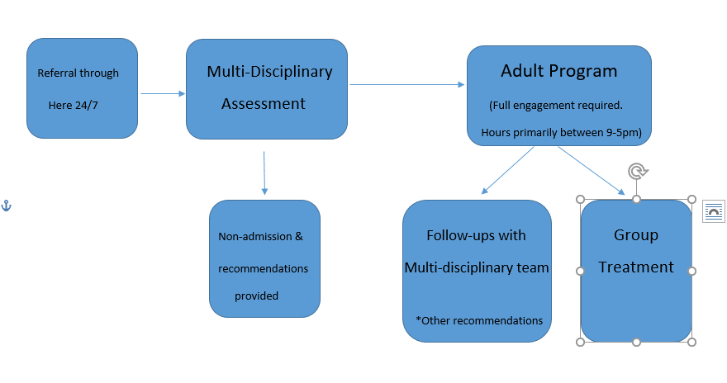
Program Overview

Slide 5
Possible Reasons for
Non-Admission/ Re-direction
More intensive Eating Disorder treatment required
Medical Instability (ie. low blood pressure, low heart rate, QT/PR prolongation, symptomatic orthostasis, BMI 16.3 or less, hypoglycemia/hypokalemia, significant dehydration, hepatic/renal/cardiovascular compromise requiring acute treatment)
Active psychotic symptomology
Significantly active suicidal ideation or behaviours
Other treatment needs are priority
Alcohol/drug use significantly impacting ability to participate in program
Current risk of refeeding syndrome
In other words… our program would not be able
to meet your needs if….

Slide 6
Non-admission/Re-direction at the time of assessment does not mean that our program will never suit your needs.
Our service may not be the right fit at assessment, but it may be the right fit at some point along your path to recovery.

Slide 7
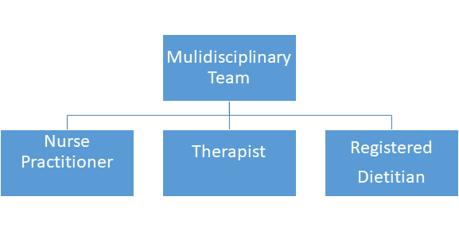
Treatment Team This would be your treatment team if your assessment has resulted in admission to the program
Due to the psychological, medical and nutritional consequences of an Eating Disorder, you would be meeting with your Eating Disorder team regularly in your journey to recovery

Slide 8
How to Best Utilize Your Team
Dietitians – discuss nutritional issues and set goals towards mechanical eating
Therapist –work on setting eating disorder related goals and discuss psychosocial factors related to your recovery journey
Nurse Practitioners –assess medical concerns related to the eating disorder (not to replace health care provider)

Slide 9
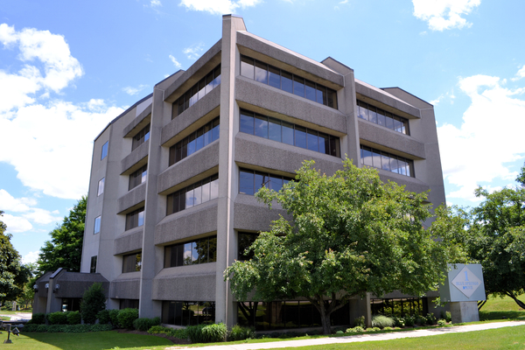
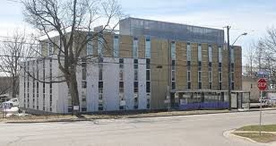
We Have Three Sites
1 Blue Springs Drive Waterloo
80 Waterloo Ave Guelph
1145 Concession Rd. Cambridge

Slide 10
CMHAWW Groups The groups are run intermittently and on an as-needed basis. Not all groups are running at all times.
Education PowerPoint
Motivation Enhancement (MET)
Skills
Symptom Interruption
Body Image
Relapse Prevention
Art Expression
Meal Support
Acceptance and Commitment Therapy (ACT)
Binge Eating Disorder group
Your Mental Health Clinician will help to identify which group may be the right fit for you during different points of your recovery.
Notes:
Program is group-based with individual follow-ups
Group therapy is the current evidence-based model for adult ED treatment
Benefits of group therapy:
-EDs can be isolating
-Support from other individuals with lived experience
-Hope and shared experience
Groups run in semesters. Typically once a week for 2 hours for a number of weeks (6-12).
You’ll be meeting with your therapist to determine which groups you’ll be attending.

Slide 11
Medical Steps – Journey to Physical Health
All body systems can be affected by an Eating Disorder and severe complications are possible.
The length of the illness can contribute to more chronic issues.
Effects of Starvation: https://youtu.be/0VfkFzjECAM
Binge Eating Disorder: https://youtu.be/E8KUhq3jH9w
Health risks with Bulimia Nervosa: https://youtu.be/YoDAtPg7Y3I

Slide 13
Nutritional Steps –Journey to Eating Well
Restrictive (Symptomatic) Eating
Mechanical Eating
Intuitive Eating
• Difficult to eat out or to eat with friends and family
•Listening to external cues, such as fad diets
•Avoiding specific or broad categories of food
•Choosing diet foods
•Dysfunctional behaviours
• Ignoring hunger & fullness
• 3 meals and 3 or more snacks each day
• Treating food as medicine
• Eating whether or not you feel hungry or nauseated
• Challenging food fears
• Increasing variety and flexibility
• Normalized eating patterns
• Re-calibrated hunger and fullness cues
• Trusting your own body
• Listening to internal cues (your body will let you know what it needs)
• Likes and dislikes are okay
• Shifts in weight may occur at first
• Eating and cooking are more enjoyable
• Small portions and/or binge episodes
• Appetite may be unpredictable at first

Slide 14
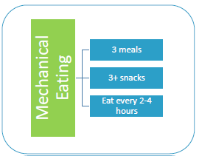
Mechanical Eating
Treat your food as medicine
Eat by the clock, every 2-4 hours within your waking hours
Plan meals and snacks in advance
Avoid diet foods
Include a variety of types of food in your diet
Remember that all foods fit into healthy eating

Slide 15
Psychological steps you can look at on your recovery journey
Self-compassion
Acceptance of where you are at
Emotion coping
Challenging thinking –thinking traps

Slide 16
Understanding the Journey

Slide 17
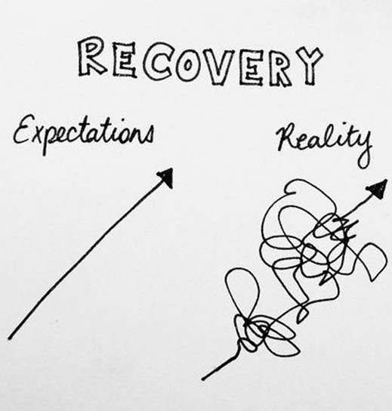
Stages of Change
Keys to change:
Understanding which stage you’re in
Recognize that change is not a linear process
Awareness that you can be in one stage of change for one behavior and in a different stage of change for another behavior
If the program isn’t the best fit for you right now you can always come back
We have an open door policy just contact here 24/7 to be rebooked

Slide 18
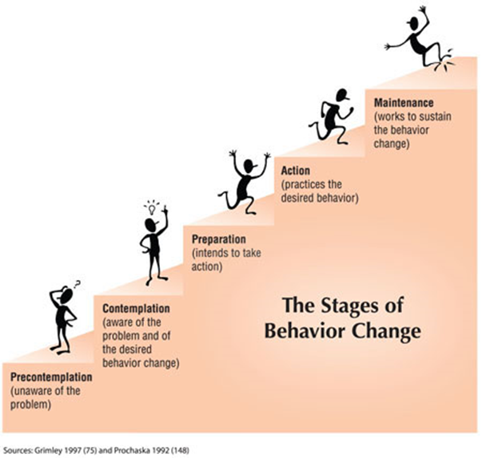

Slide 19
Diets can be Harmful
Diets are all around us and most of us have been influenced by our diet culture in some way
The truth is that diets can lead to Eating Disorders and poor physical and psychological outcomes
Resisting our diet culture can be difficult and painful
Fad diets do NOT result in long-term weight loss
The diet industry relies on our culture of the "thin ideal" to make billions of dollars every year

Slide 21
Validation of contributing factors
There is no single cause for eating disorders, however, there are many contributing factors
Biology
Family
Culture
Personal Characters
Emotional Struggles
Life changes and stresses
Trauma

Slide 23
Quote from past client
I want to remind you that your eating disorder is not
your fault; it is a complex illness that has happened to you - not by choice. I want to encourage you to let go of the guilt and shame you may be feeling (like I used to), and instead see yourself as a strong and courageous person who has chosen to fight for your health and freedom. Don’t rush yourself - change often happens a little bit at a time… you may not see big changes but
they are happening. Be proud of yourself, and
celebrate every small success during
your recovery.
SM

Slide 24
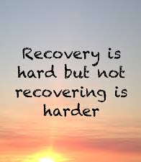
Quote from past client
This second time going through the program, something finally switched in my brain and the number no longer mattered. It was the freest I have ever felt.
Nikki

Slide 25
Everyone Deserves Recovery.

Slide 26
Recovery is Possible

Slide 27
Health is Possible
With a nourished body and brain you can optimize your health
This is very individual

Slide 28
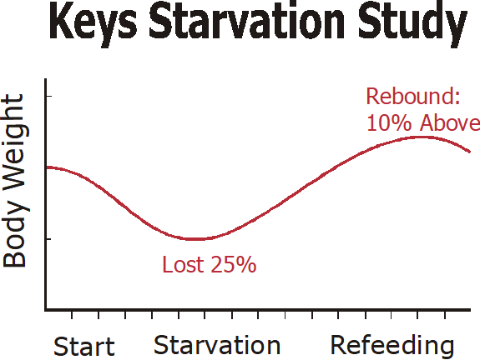
Health is Possible
Weight and appetite can stabilize with normalized eating
A group of 36 healthy men were studied as they lost weight.
During refeeding:
Weight returned to their pre-experiment norm within 6 months-2 years
Metabolism increased
Normalized hunger cues returned
All psychological symptoms stopped

Slide 29
What Full Recovery Looks Like

Slide 30
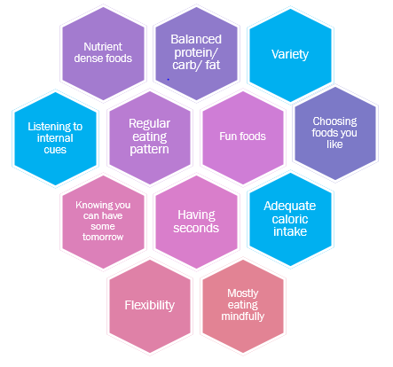
Eating Competence
Listening, hearing and respecting hunger cues
Enjoying food and feeling good about enjoying it
Being calm around unfamiliar food and being able to try new foods
Planning for meals and snacks through the day

Slide 31
Quote From a Past Client
Today I’m a totally changed person. I love myself for who I am. I’m not constantly thinking about food every minute of every day. I enjoy holidays with my family, I don’t have panic attacks when going to restaurants, I do sports and exercise for fun, and I feel happy to be alive. I no longer avoid getting together with people because I’m afraid of the food that will be served - I can relax and feel peace and live my life without restriction, rules and obsessions. I trust my body, and I trust myself. Not every day is perfect, and it doesn’t have to be - because I will get through it and my ED won’t be what I use to cope anymore. It feels amazing… and I never thought I could feel like this again.
SM

Slide 32
Psychological Recovery
Improved Body Image
Improved Emotion Coping
Improved Relationships
Improved Self-Acceptance
Recovery can look different for everyone
Improved Quality of Life
Improved Self-Compassion

Slide 33
Recovery is Attainable
Change how you see...not the way you look.

